Slide 1
Recent Trends in VLSI Design, Signal Processing & Optimization based on EDA tools
Date 10/11/2020 Time 10am onwoards

Slide 2
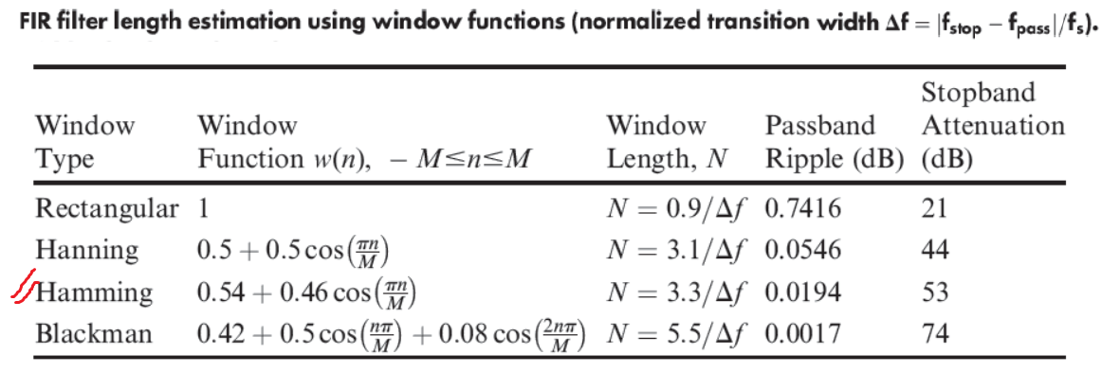
Hardware implementation of Multirate DSP blocks
1] Downsample Block downsample(x,n)
2] Upsample Block upsample(x,n)
3] Decimation Block decimate(x,n) [ filter + downsample ]
4] Interpolation Block interp(x,n) [ upsample + filter ]

Slide 3
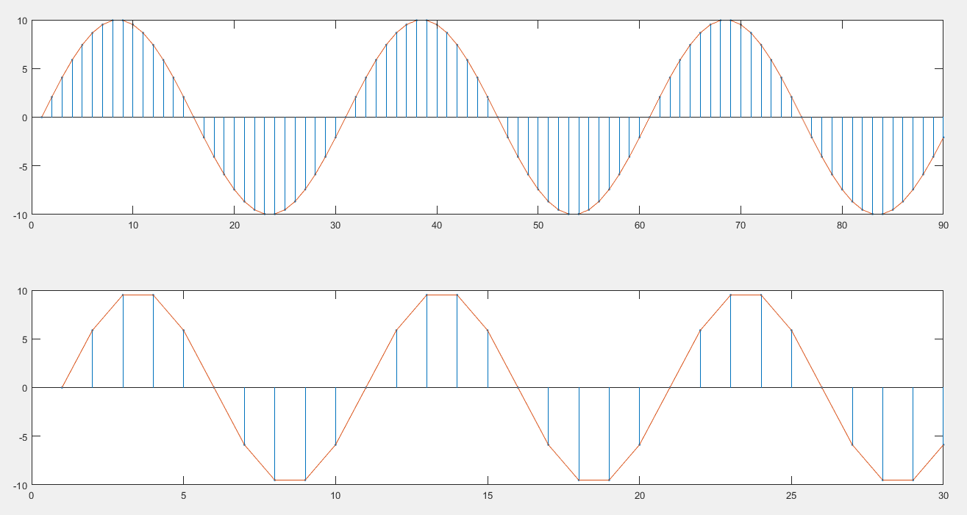
Downsample effect on signal

Slide 4
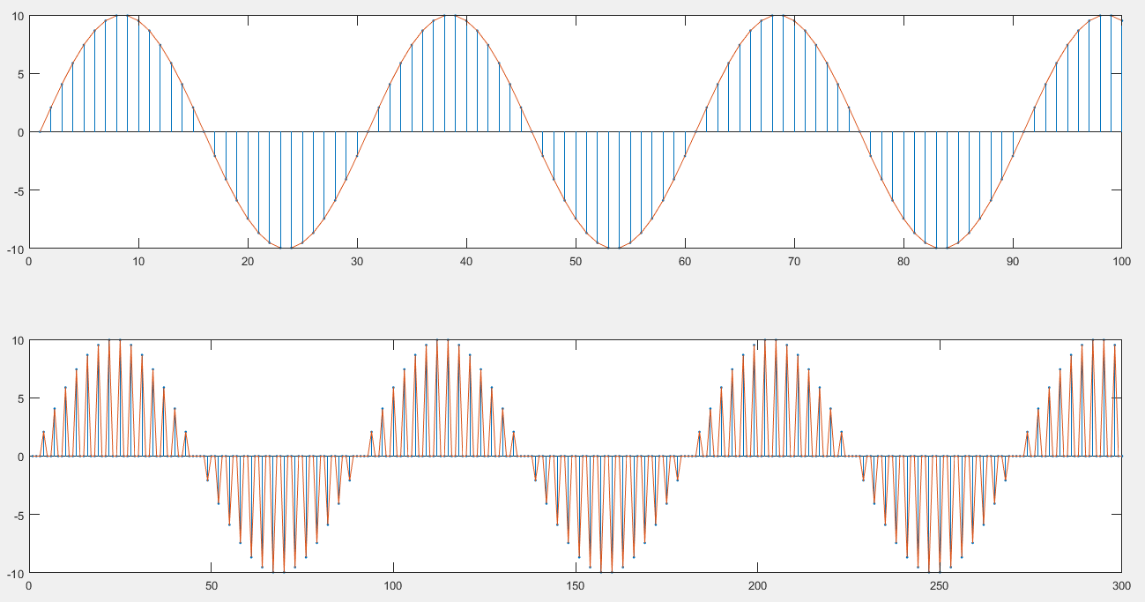
upsample effect on signal

Slide 5
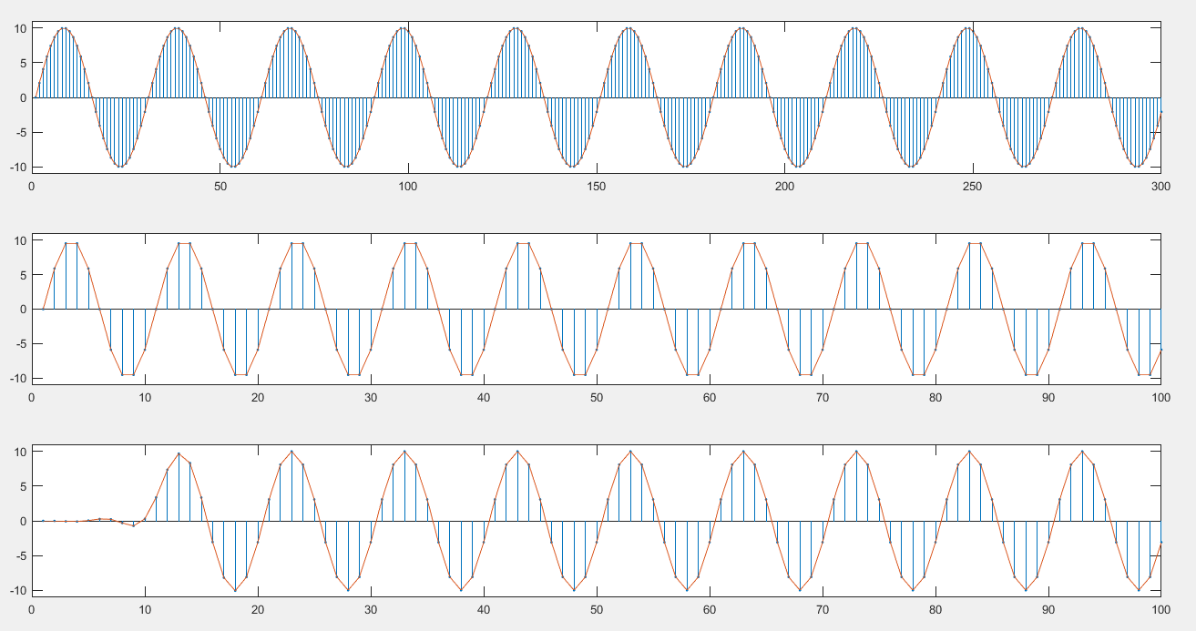
decimate effect on signal

Slide 6
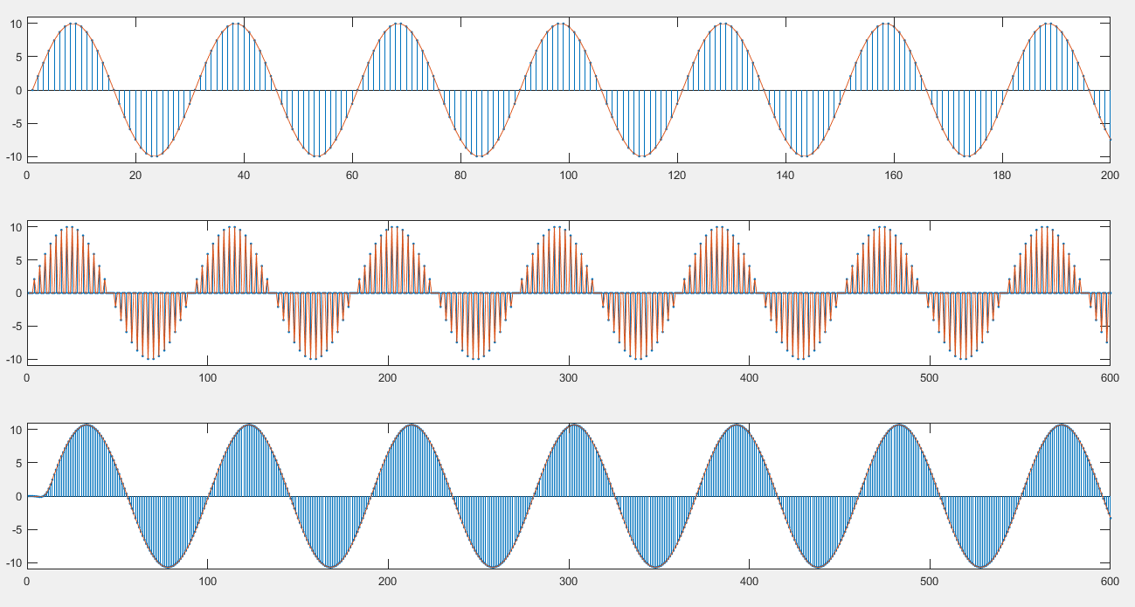
interpolation effect on signal

Slide 7
Application:- Simple Channelizer using up and down sampler
Let there are 4 signals and need to transmitted these signals using a single channel
1] Signals are x1, x2 ,x3 x4
2] upsample these signals by 4
3] pads 0s to x2 to x4 by 1, 2, 3
4] add all to create the mix signal
5] transmitted it
6] downsample it by 4 , thro chain of delay block with value 0 1 2 3
7] you will get the all 4 signals back ,

Slide 8
Advantages / Applications
Data converters
High resolution display
Reduces the storage requirement / memory
oversampling
reduced order filters
lower sampling rate
realizable filters
faster and easier calculations
interpolating the data
discard undesired samples
pack-unpack => zip/unzip
and many more

Slide 9
For hardware implementation Tools required are as
Matlab:- for signal generation and design code for multi-rate units
Active HDL:- for hdl code design, compile and simulate
Vivado :- Hardware platform for syntheses and validation by simulation

Slide 10
Basic elements needed for implementation of multirate units are as
1] D flip-flops
2] mux
3] clock divider
4] clock multiplier , PLL / MMCM IP can be used for this
5] filter , here we are using 19-20 tap fir filter
6] for clock controlling fsm may be required
For testing we need signal as well , will generate from matlab

Slide 11
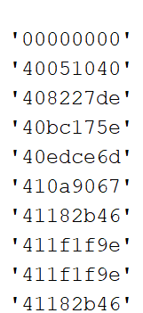
%% signal generation and convert to 32 bit hex format
clc ; clear all
%%
fs = 6e3; % sampling frequency
t = (0:1/fs:0.2)';
fc = 200; % signal frequency
x1 = 10*sin(2*pi*fc*t)'; % signal
%%
t=[]; % all sample values in variable t (hex 32 bit)
for pnt=1:size(x1,2)
t1 = [ float2bin(x1(pnt)) ];
t = [t;t1];
end
allcnvfiles.txt

Slide 12
`timescale 1ns / 1ps
module test_signal2();
reg clk,reset;
reg [31:0] datax;
//dut instantiation
initial clk = 1'b1;
always #5 clk = ~clk;
initial begin
reset = 1'b1;
#20 reset = 1'b0;
end
integer file_read,read;
initial
begin
file_read = $fopen("allcnvfiles.txt","r");
End
initial
begin
while (!$feof(file_read))
begin
@(posedge clk);
read <= $fscanf(file_read,"%x\n",datax);
end
@(posedge clk);
$fclose(file_read);
end
endmodule

Slide 13
entity datagen3 is
port ( clk : in std_logic;
rst : in std_logic;
x : out std_logic_vector(31 downto 0)
);
end datagen3;
architecture Behavioral of datagen3 is
constant N: integer := 1201; --
type arr is array (1 to N) of std_logic_vector(31 downto 0);
constant sd : arr :=
(
x"00000000",
x"40051040",
x"408227de",
x"2a51b191“ );
begin
-- code start
input: process (clk, rst)
variable i : integer := 1; -- i = 0 ;
begin
if (rst = '1') then
x <= (others => '0');
i := 1;
elsif (clk'event and clk = '1') AND (i<N) then
x <= sd(i);
i := i +1;
end if;
end process;
end ;

Slide 14
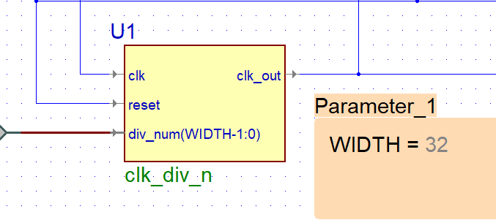
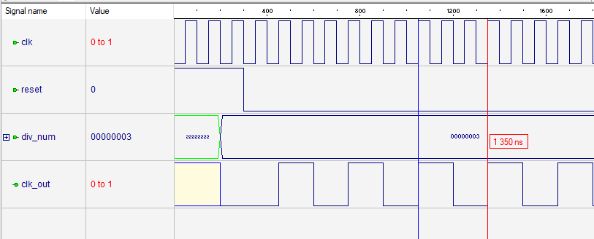
Clock divider

Slide 15
Clock multiplier >> MMCM/PLL ip
Cover code
Clk out , lockout
TB
IP
Clk in , reset

Slide 16
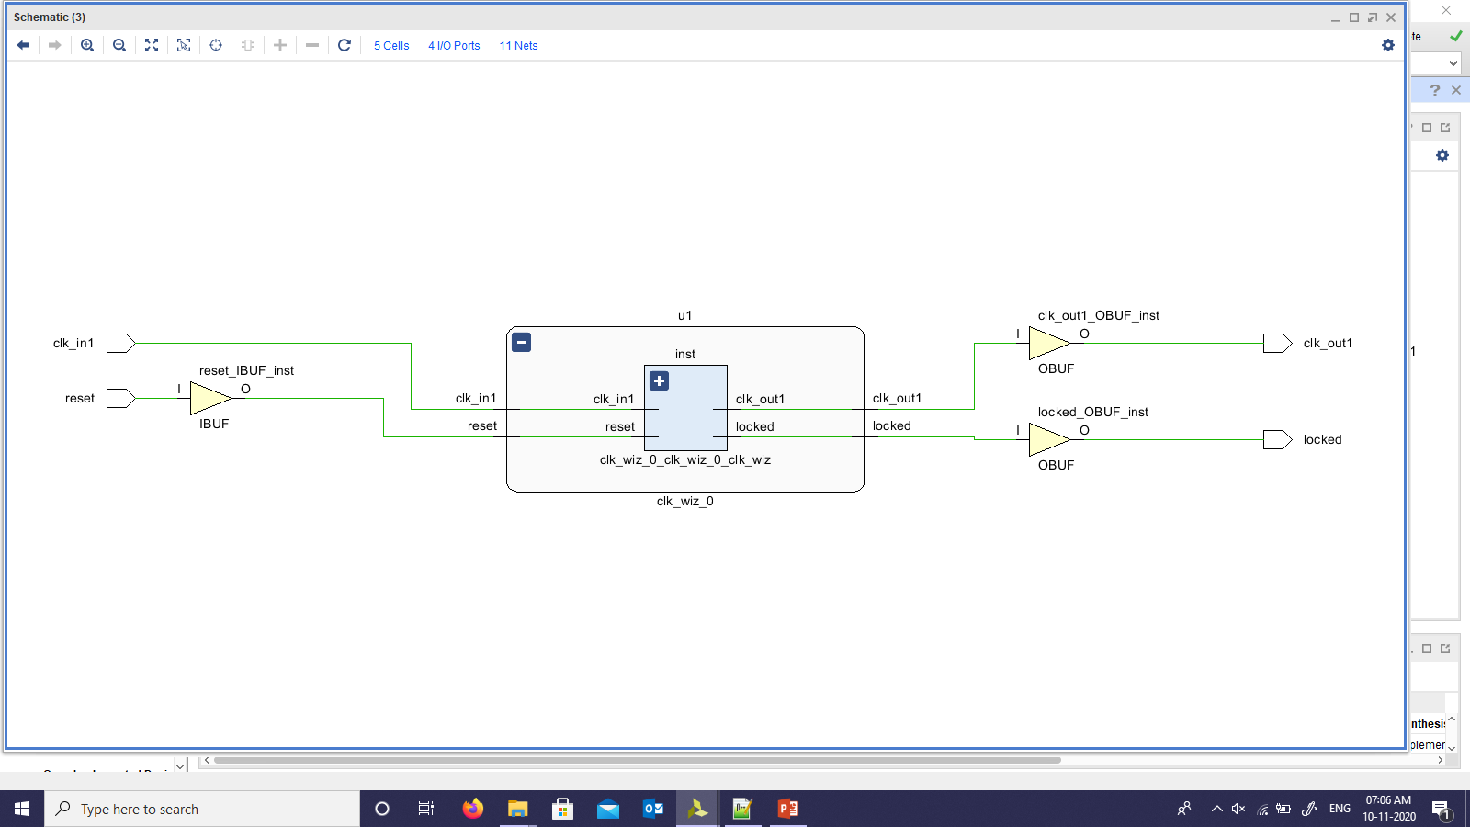

Slide 17
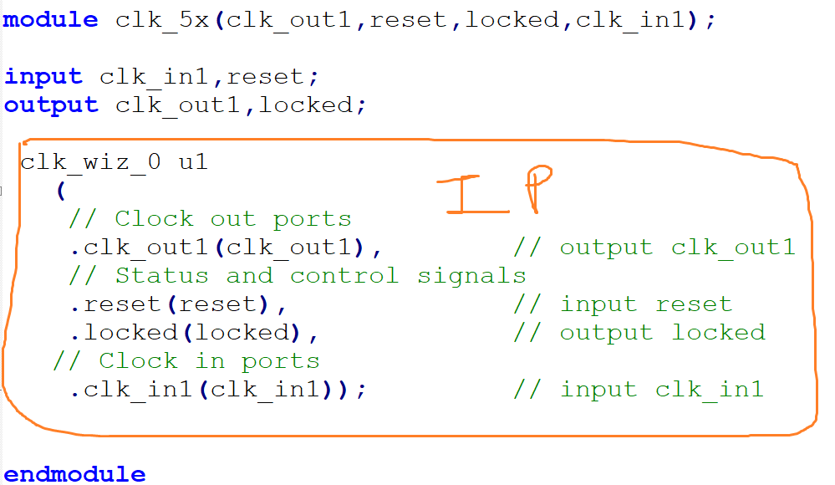
Cover code

Slide 18
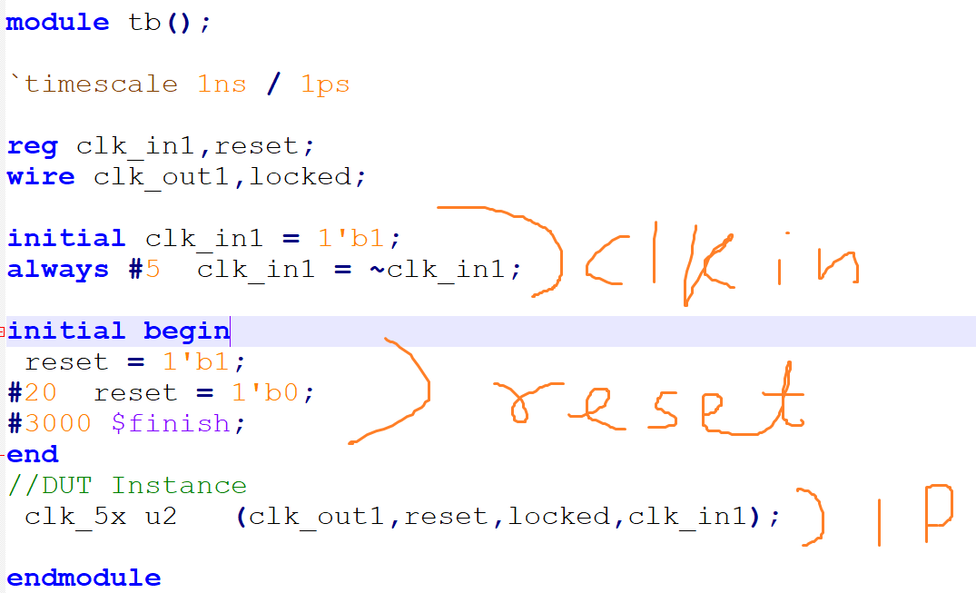
test bench code

Slide 19
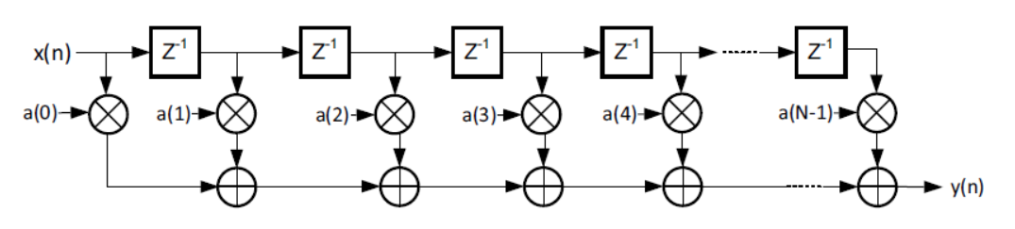
Direct form of FIR filter

Slide 20
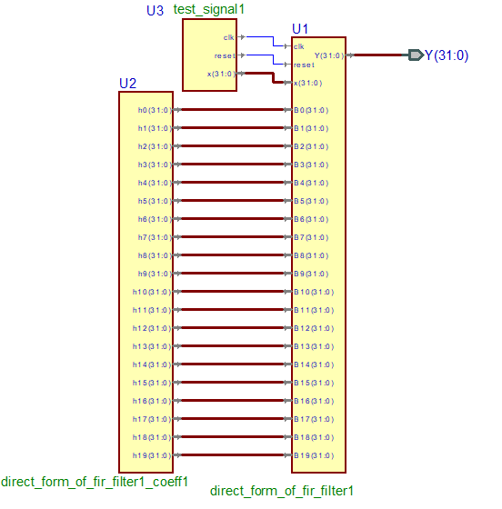

Slide 21
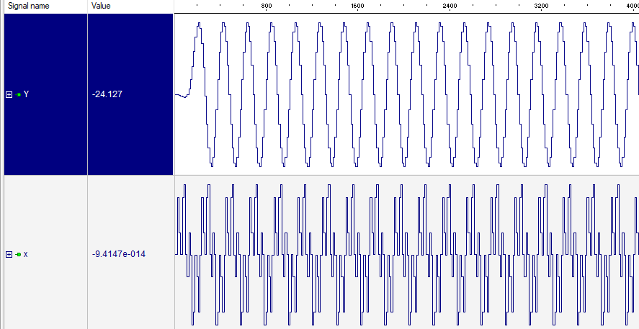

Slide 22
Downsampler block diagram
x = [ 1 5 4 6 7 8 9 1 11 4 6 9];
dnx = downsample(x,3);
dnx = 1 6 9 4

Slide 23
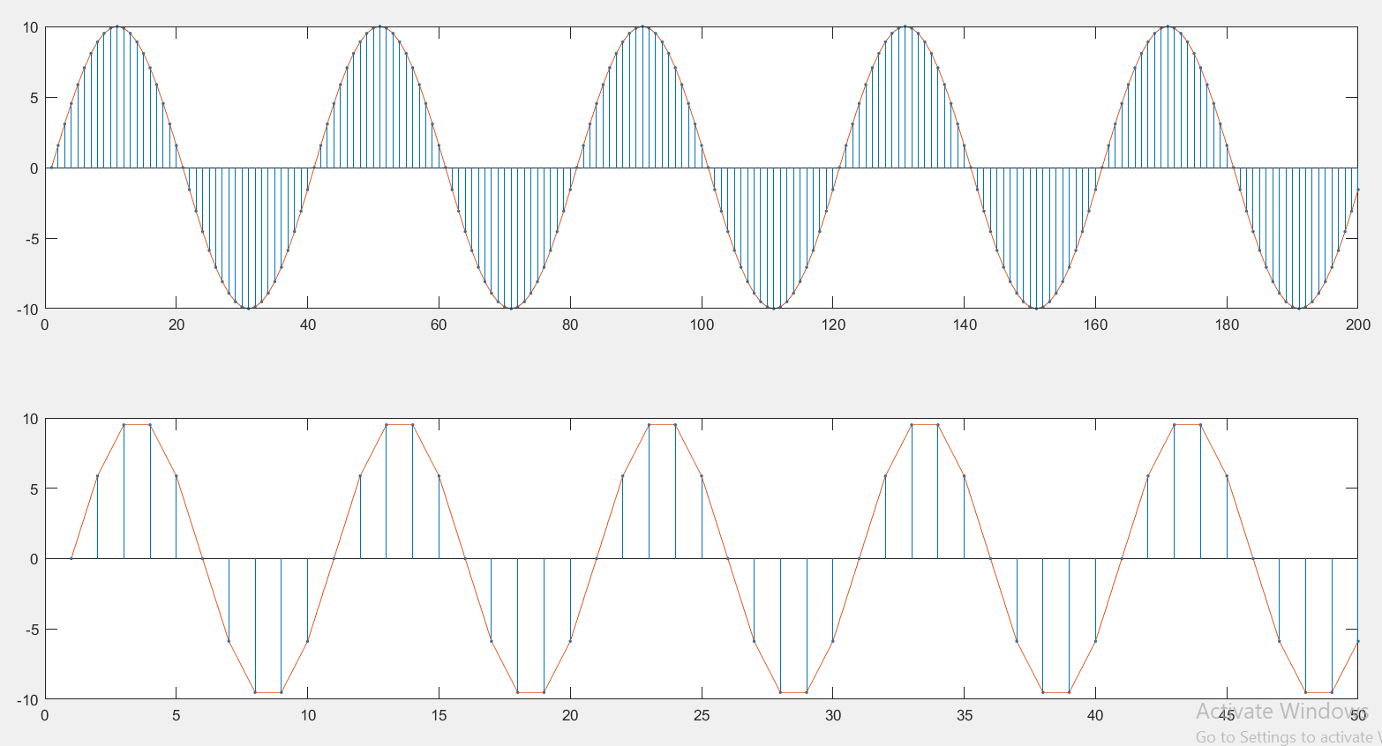
Matlab plot of same data and approach

Slide 24
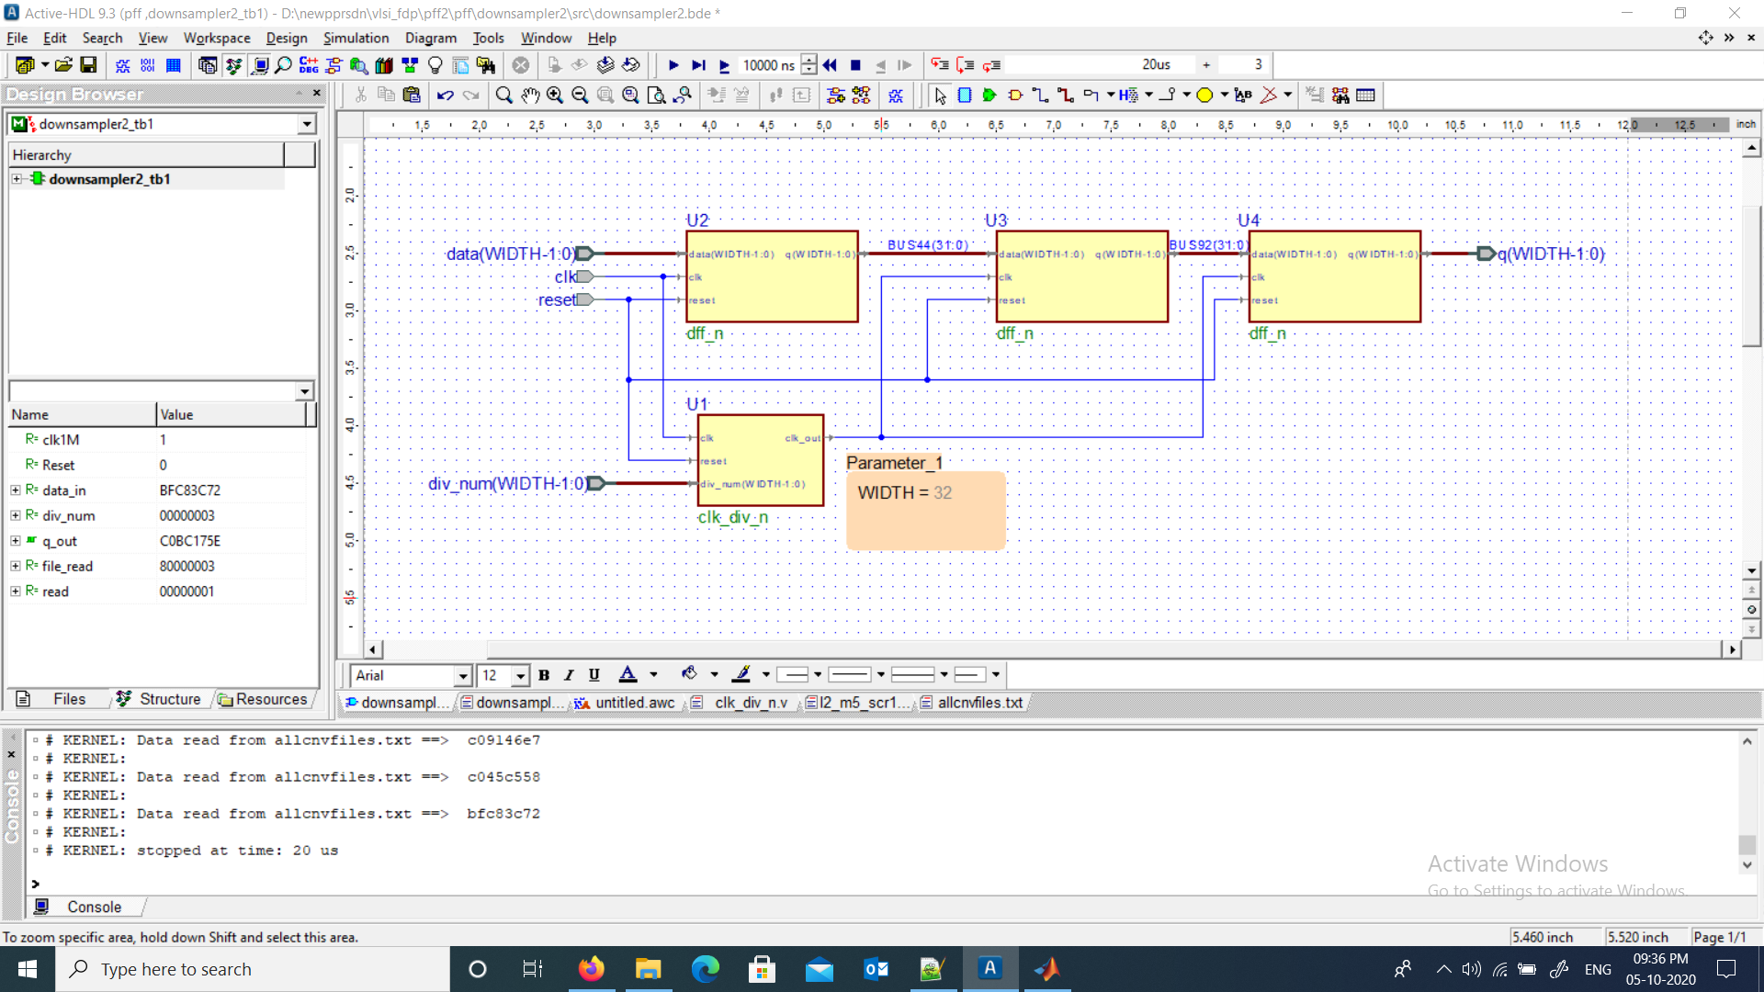
Down sampler circuit

Slide 25
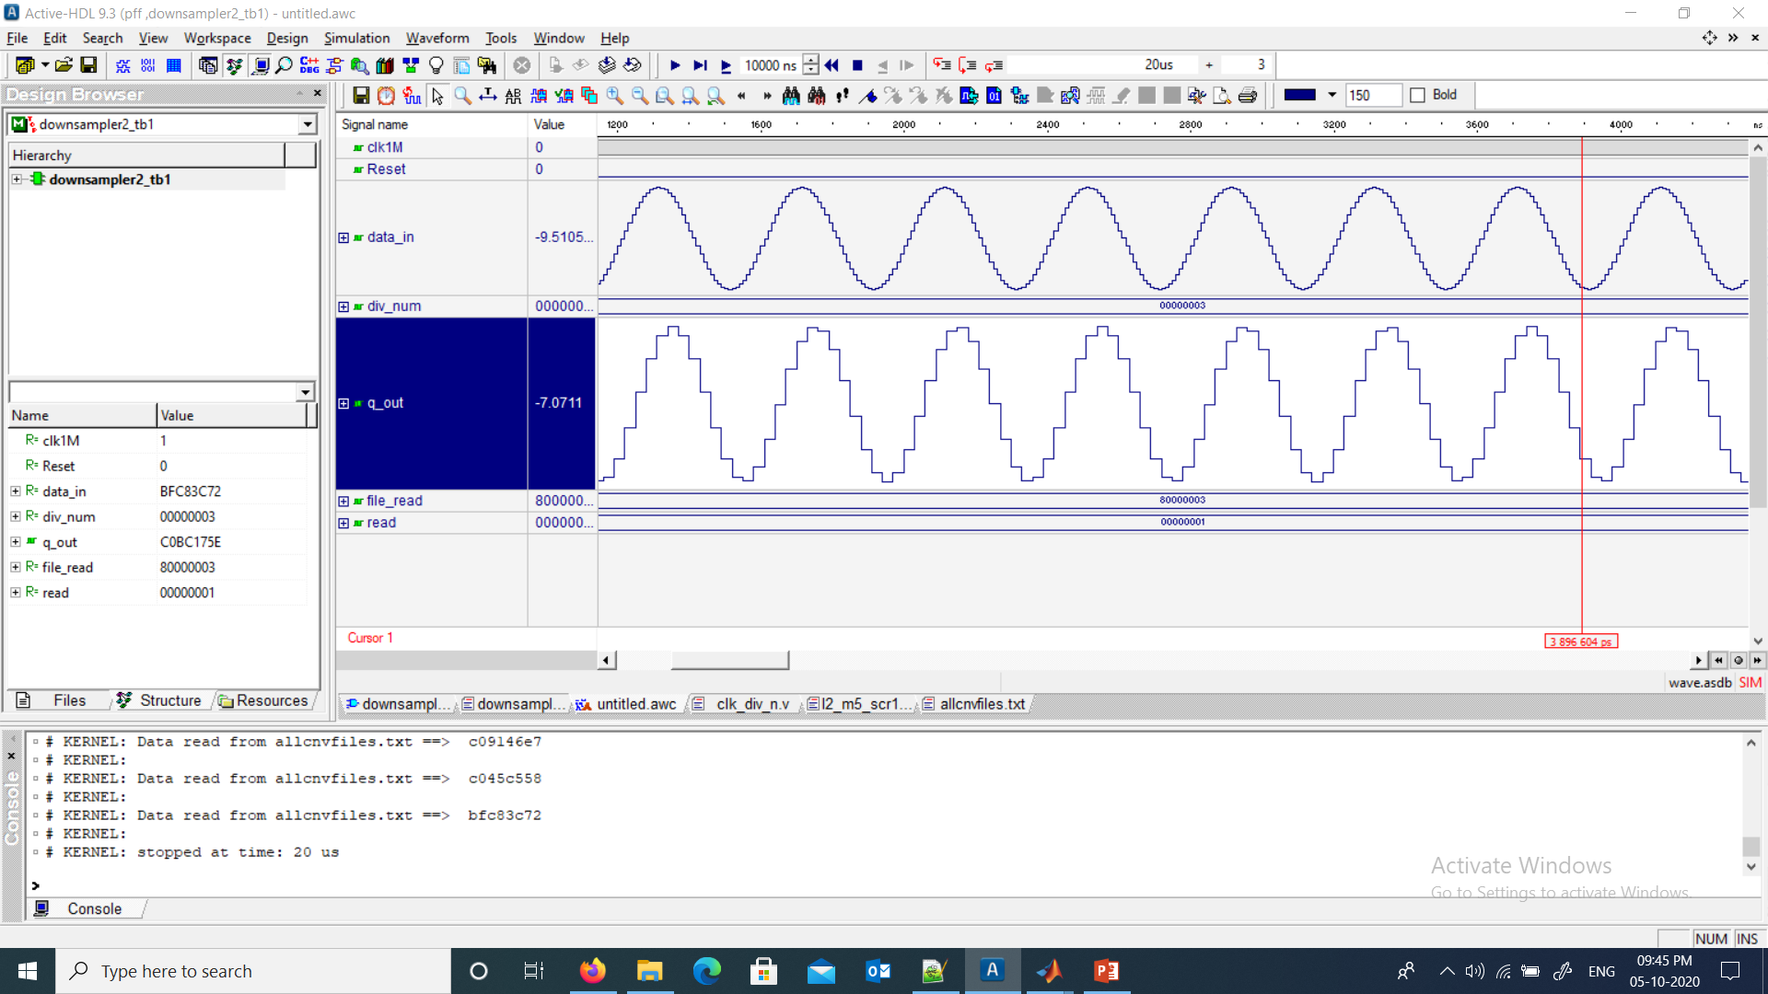
Down sampler circuit simulation result

Slide 26
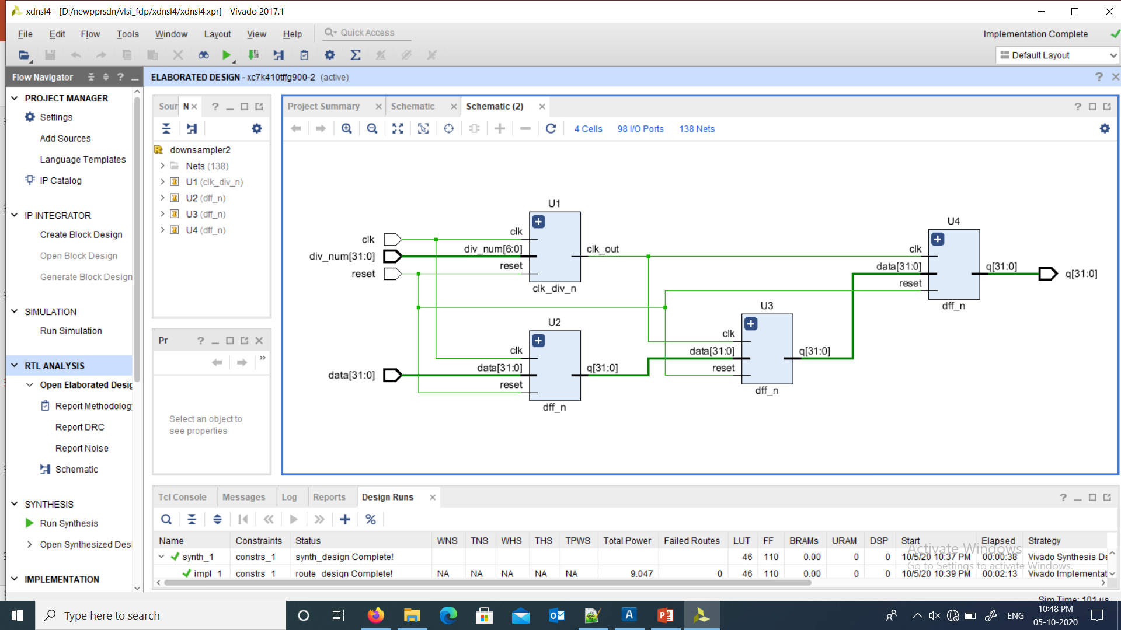
Down sampler schematic from vivado

Slide 27
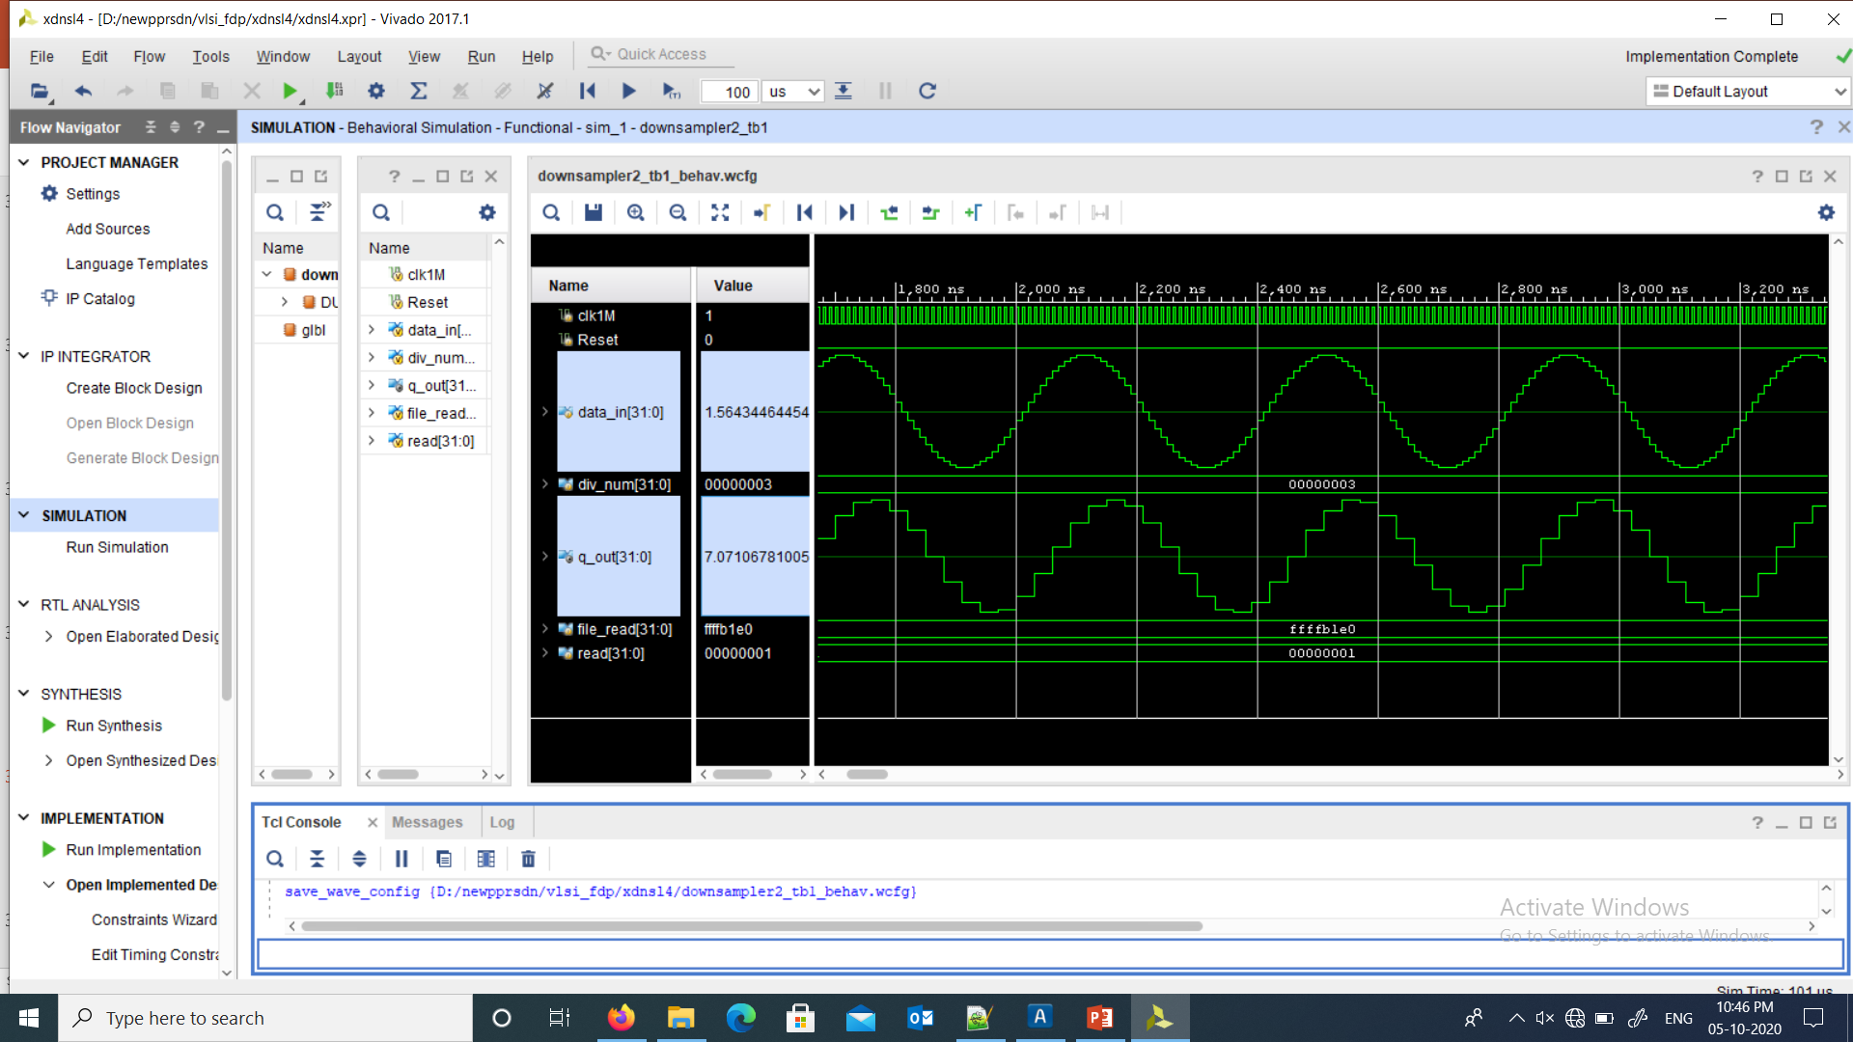
Down sampler simulation from vivado

Slide 28
Upsampler block diagram
x = [ 1 5 4 6 7 8 9 1 11 4 6 9];
upx = upsample(x,3);
1 0 0 5 0 0 4 0 0 6 0 0 7 0 0 8….
A B B A B B A B B A B B A B B A….

Slide 29
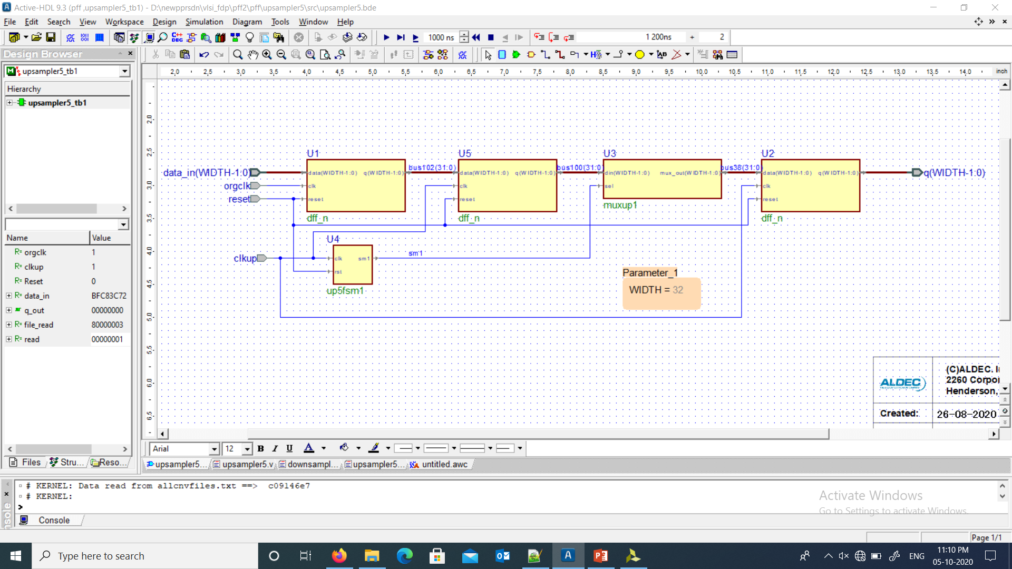
Upsampler circuit

Slide 30
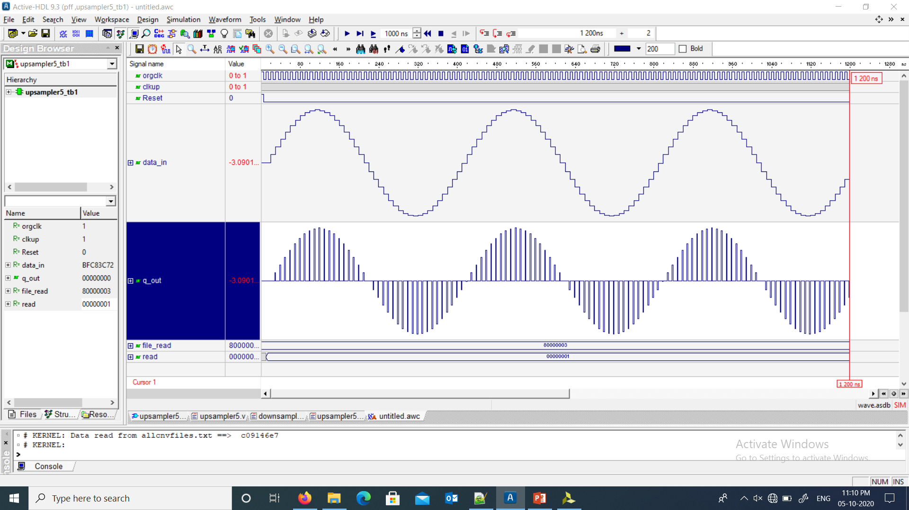
Upsampler circuit simulation result

Slide 31
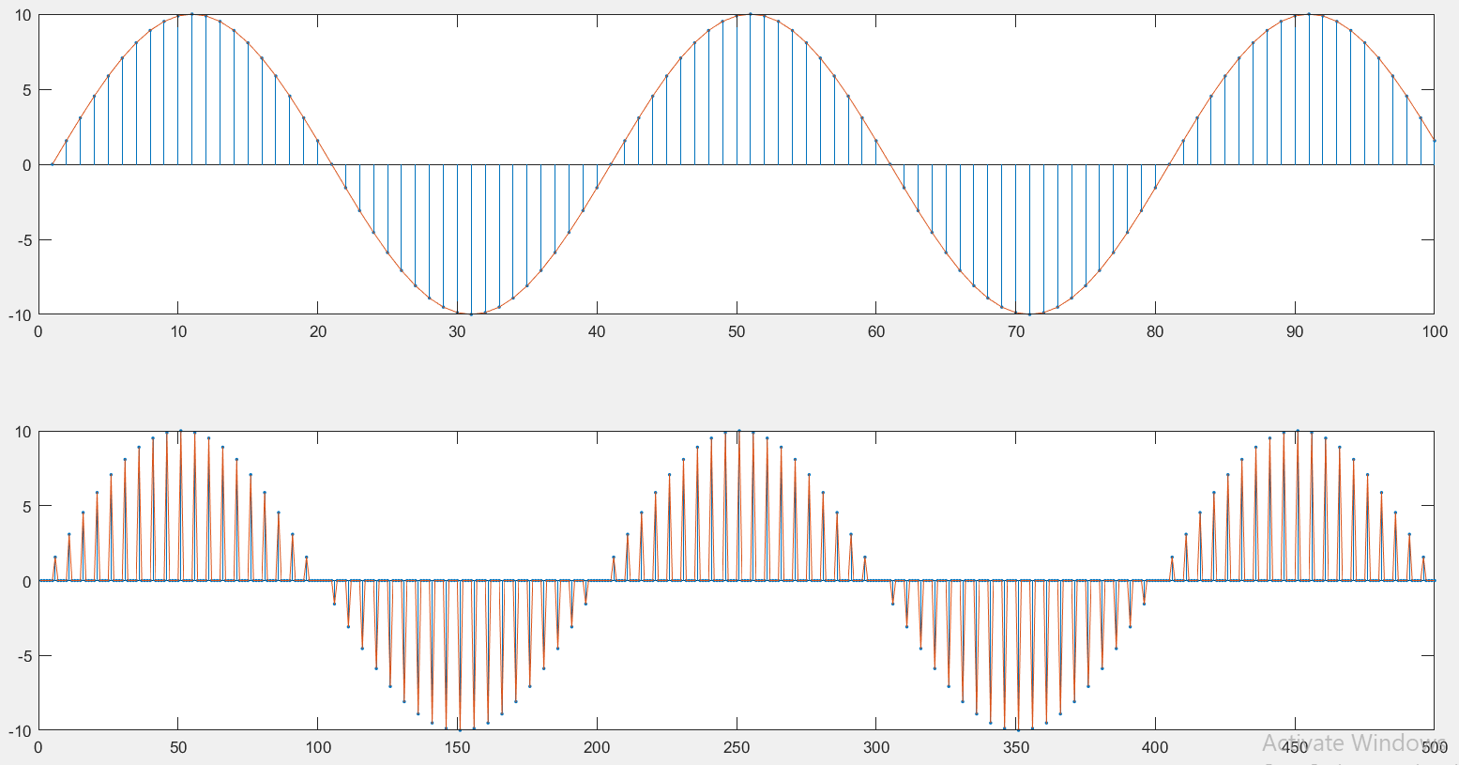
Matlab plot of same data and approach

Slide 32
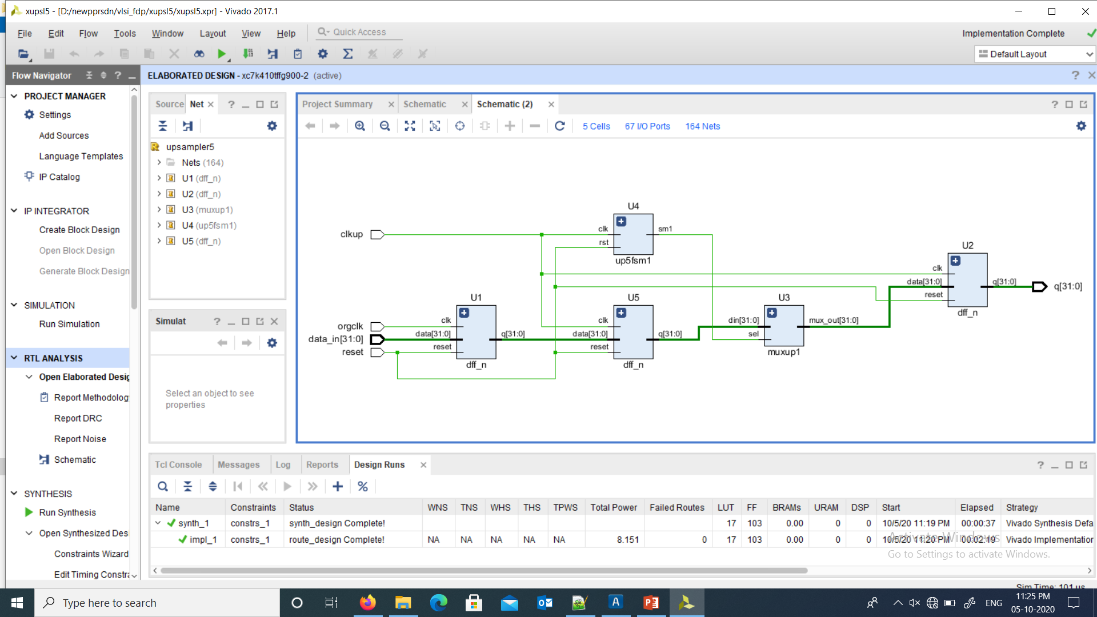
Upsampler schematic from vivado

Slide 33
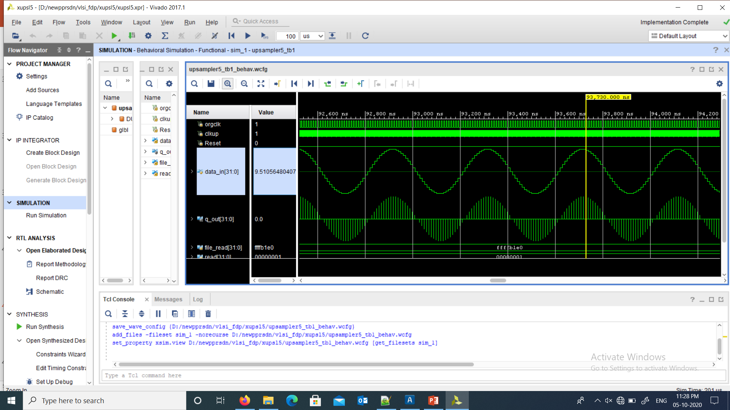
Upsampler simulation from vivado

Slide 34
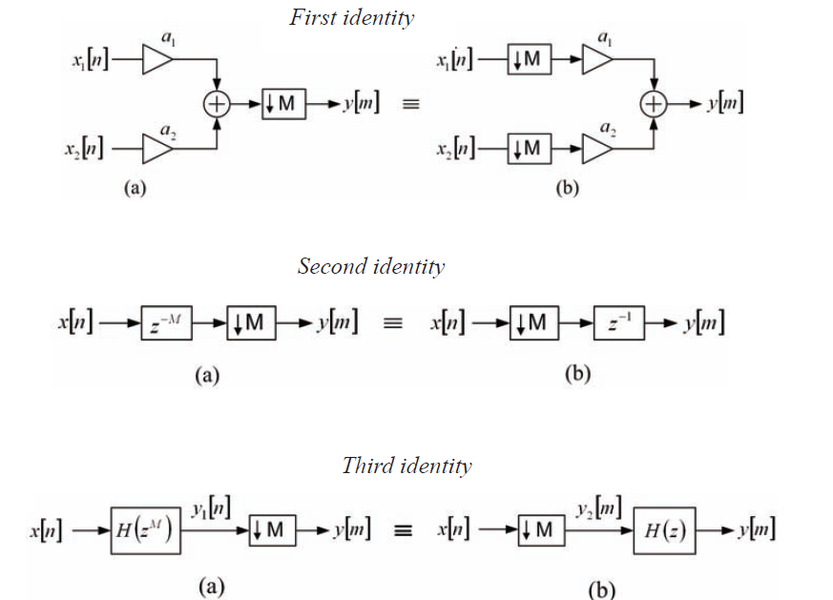
Multirate Noble Identities

Slide 35
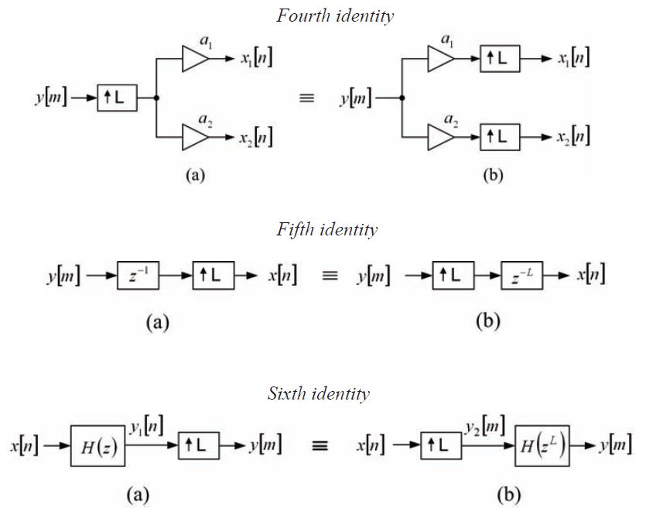

Slide 36
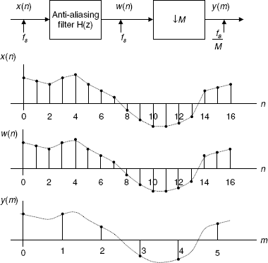
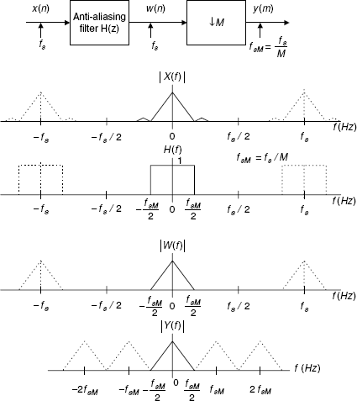
Decimation

Slide 37
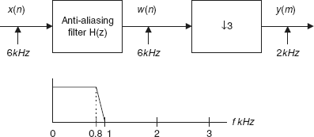
calculation of filter length and its edge
Anti-aliasing filter operating at the sampling rate = 6000 Hz
Passband frequency range = 0–800 Hz
Stopband frequency range = 1–3 kHz
Passband ripple = 0.02 dB
Stopband attenuation = 50 dB
Filter type = FIR.
The Hamming window is selected,
since it provides 0.019 dB ripple and 53 dB stopband attenuation. The normalized transition band is given by
Δf = (f _{stop} – f _{pass} )/f _{s}
= (1000 – 800)/6000
= 0.033.
The length of the filter and the cutoff frequency can be determined by
N = 3.3/Δf
= 3.3/0.033
= 100
We choose the odd number, that is, N = 101, and
f _{c} = (f _{pass} + f _{stop} )/2
= (800 + 1000)/2
= 900 Hz.

Slide 38
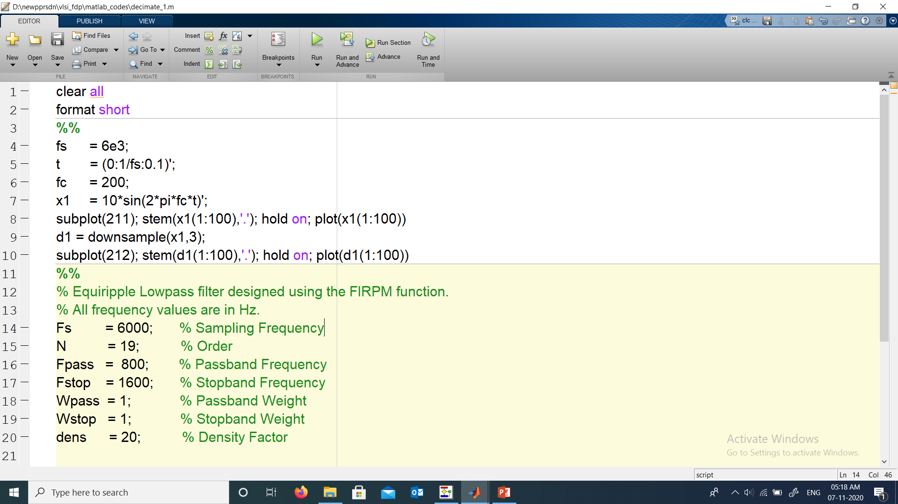
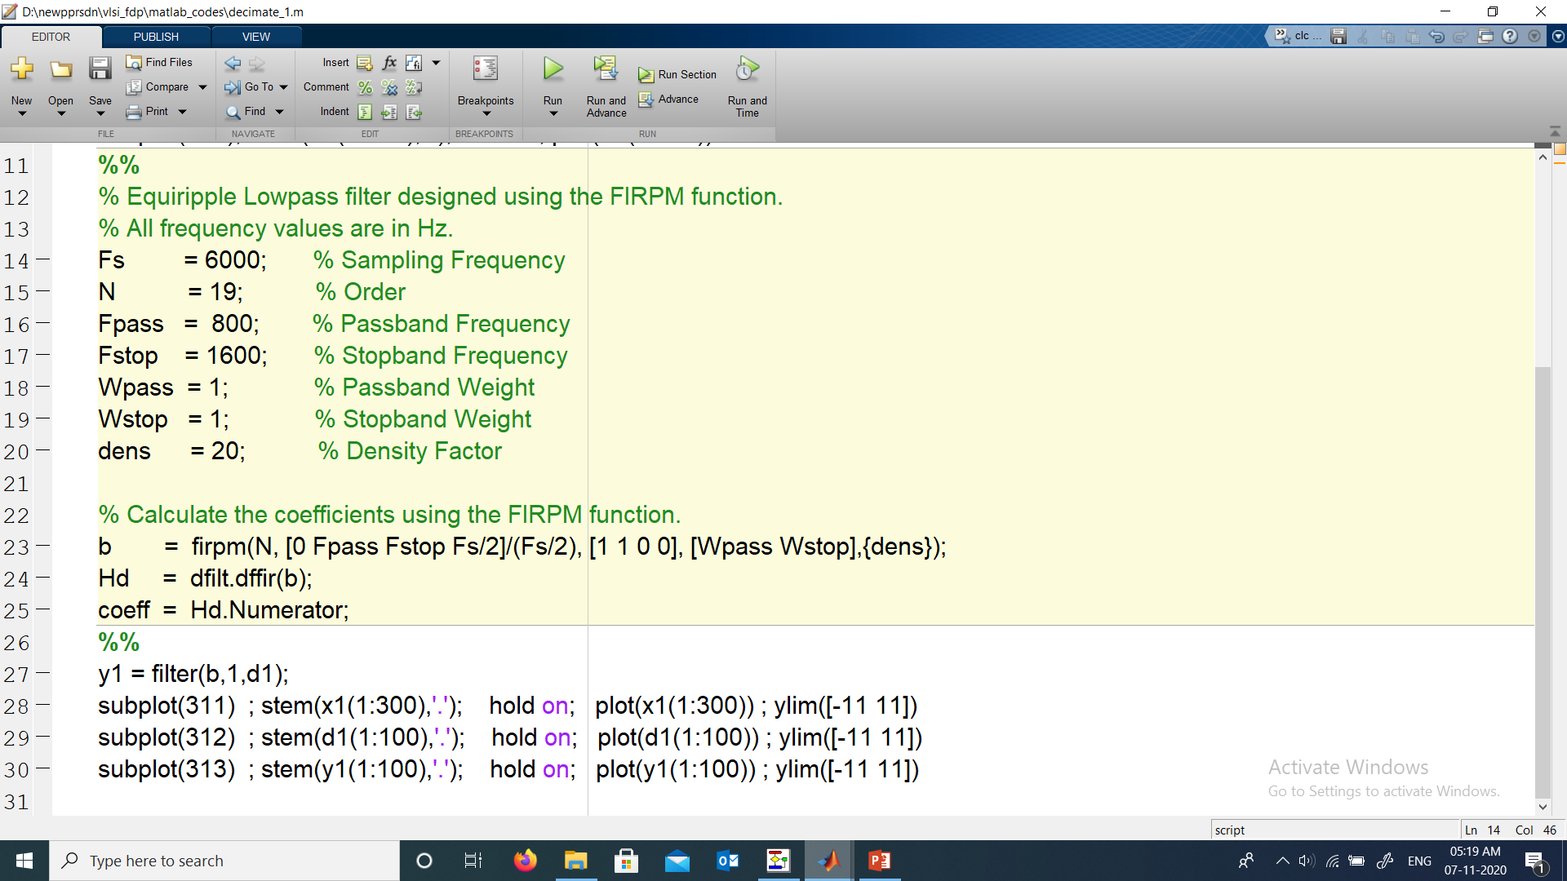
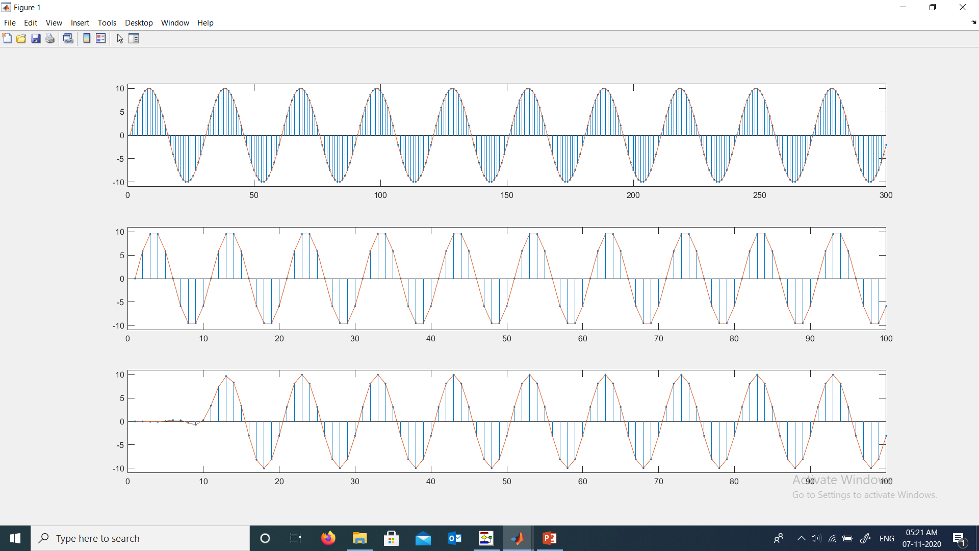
x1
d1
y1

Slide 39
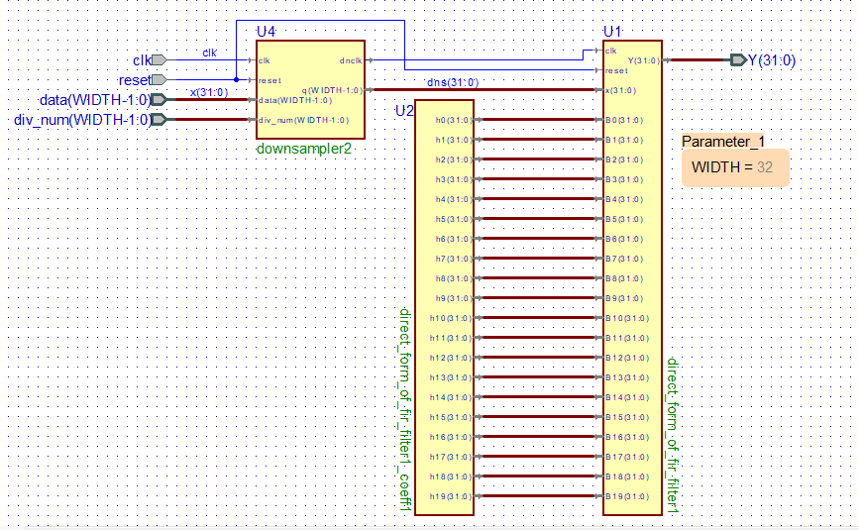
filter

Slide 40
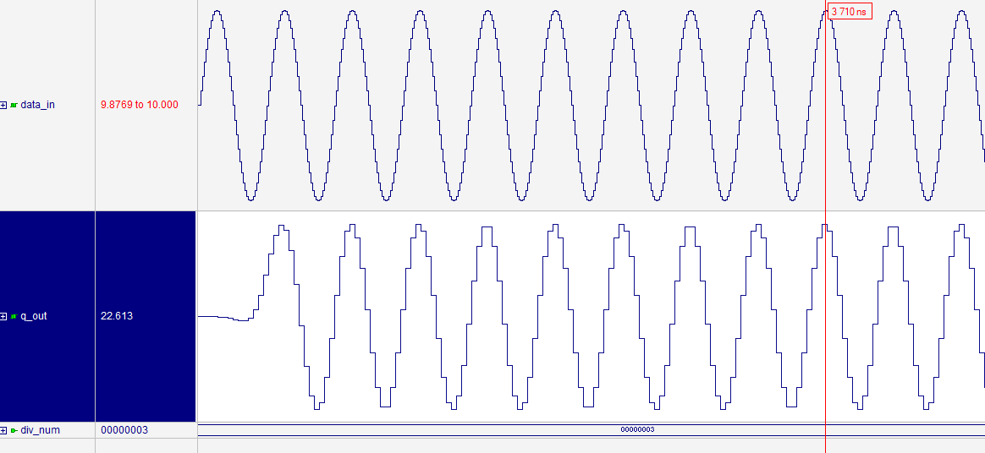

Slide 41
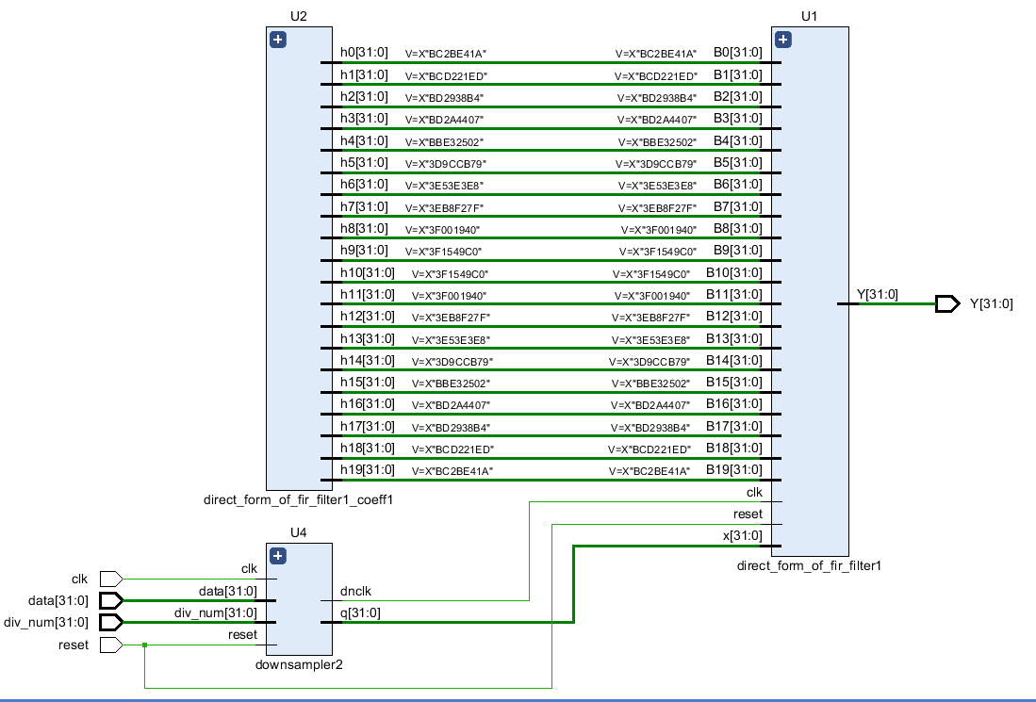

Slide 42
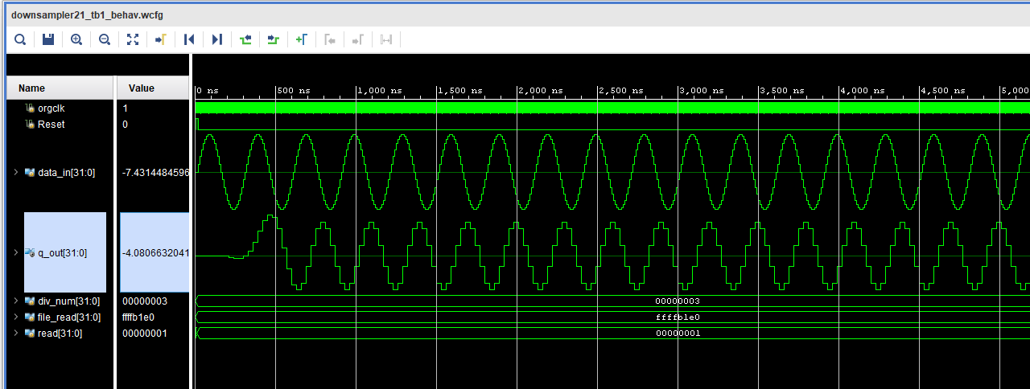

Slide 43
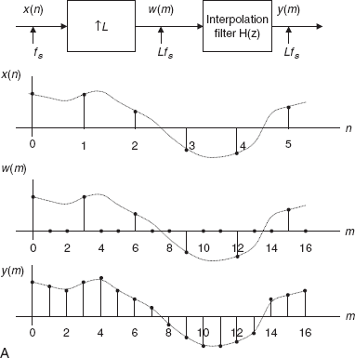
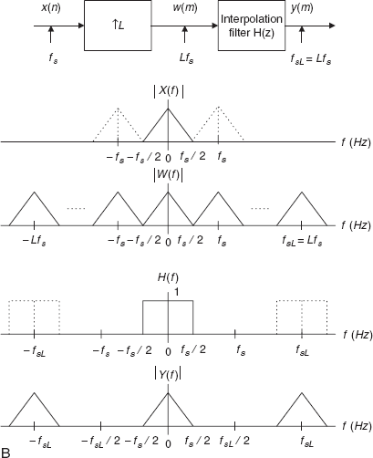
Interpolation

Slide 44
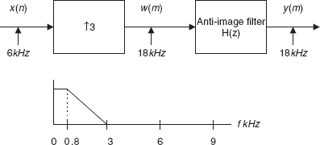
calculation of filter length and its edge
Interpolation filter operating at the sampling rate = 18,000 Hz
Passband frequency range = 0–800 Hz
Stopband frequency range = 3–9 kHz
Passband ripple = 0.02 dB
Stopband attenuation = 50 dB
Filter type = FIR.
The normalized transition band is
Δf = (f _{stop} – f _{pass} )/f _{sL}
= (3000 – 800)/18000
= 0.1222.
The length of the filter and the cutoff frequency can be determined by
N = 3.3/Δf
= 3.3/0.1222
= 27,
and the cutoff frequency is given by
f _{c} = (f _{pass} + f _{stop} )/2
= (3000 + 800)/2
= 1900 Hz.

Slide 45
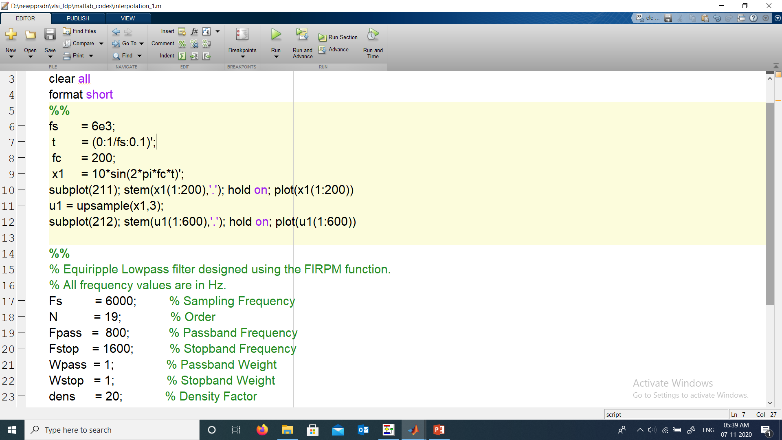
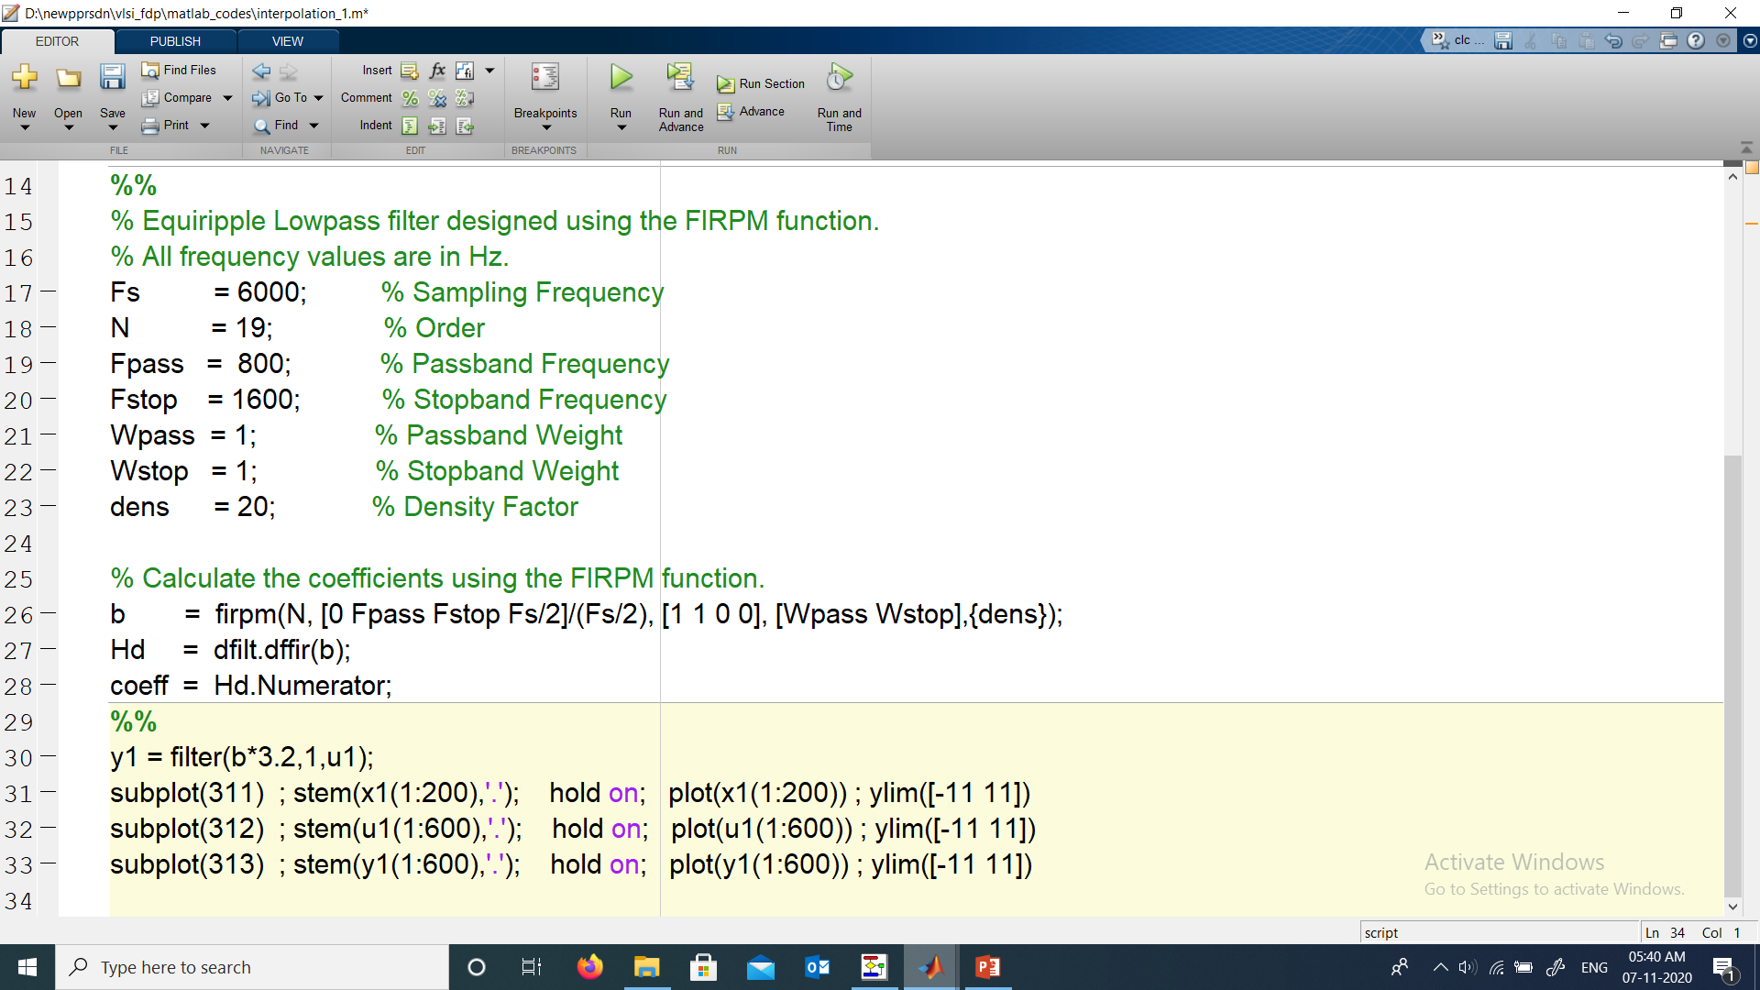
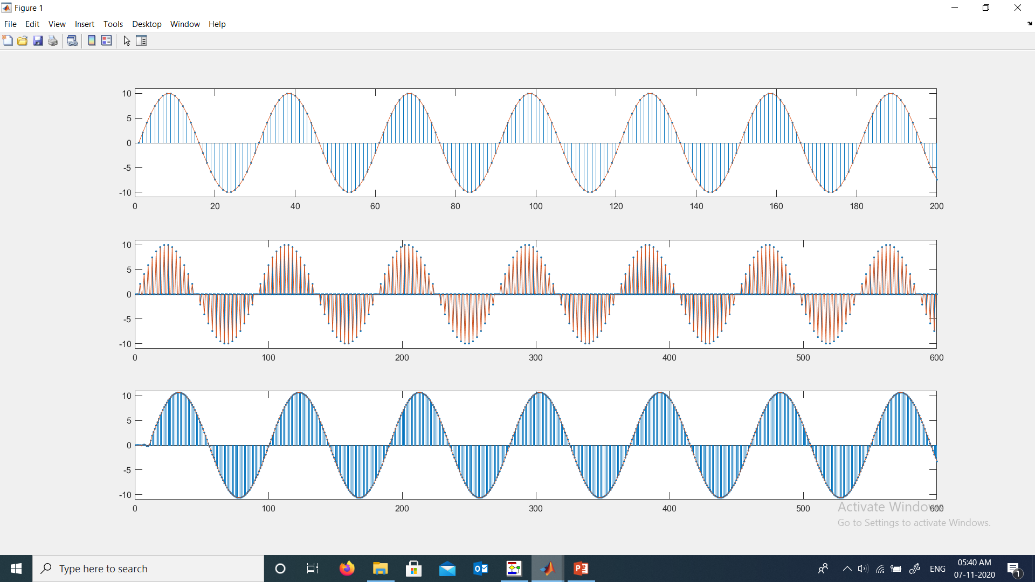
x1
u1
y1

Slide 46
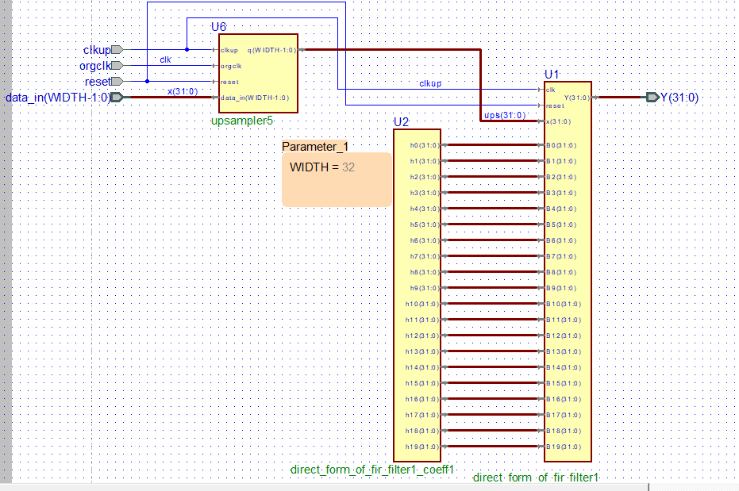
filter

Slide 47
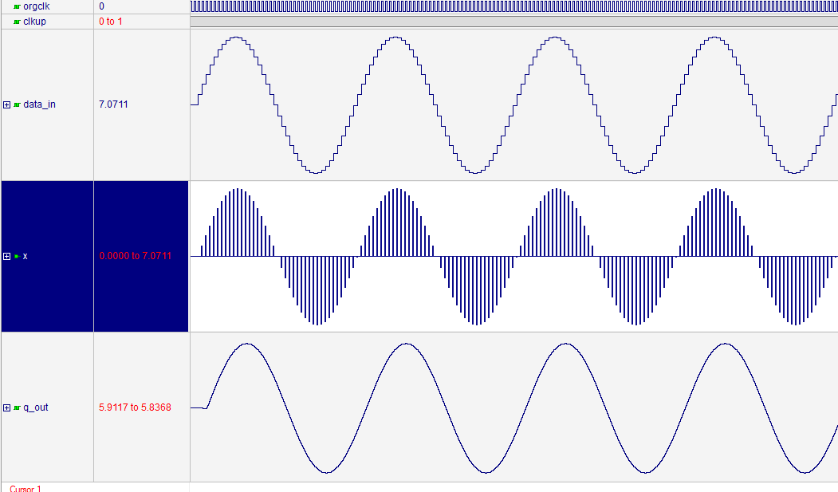

Slide 48
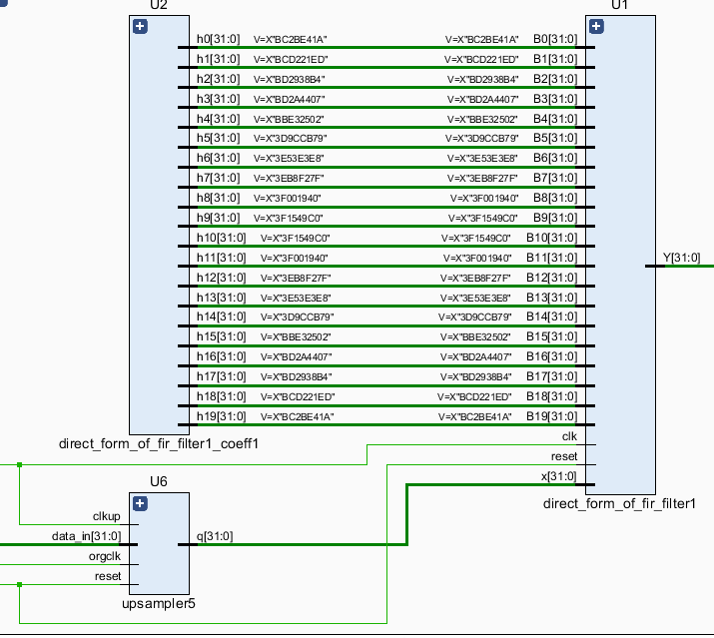

Slide 49
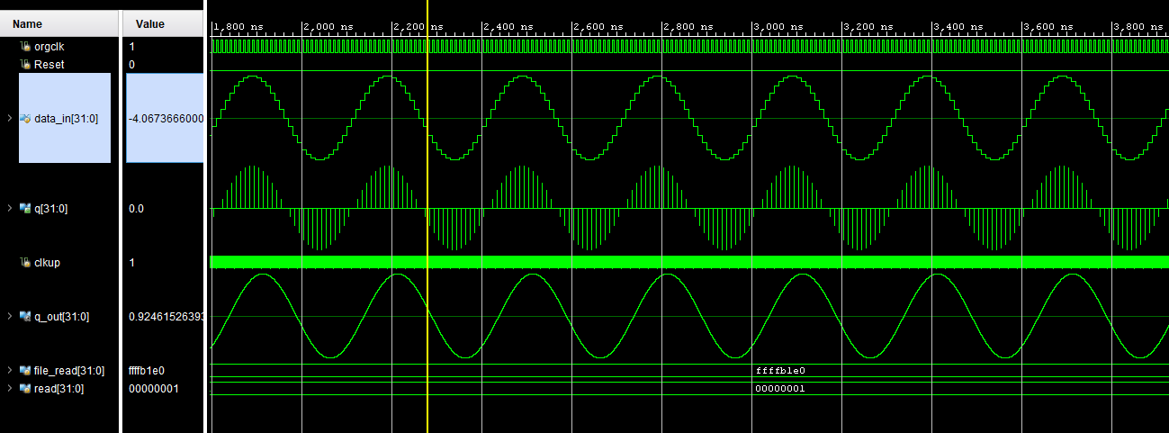

Slide 50
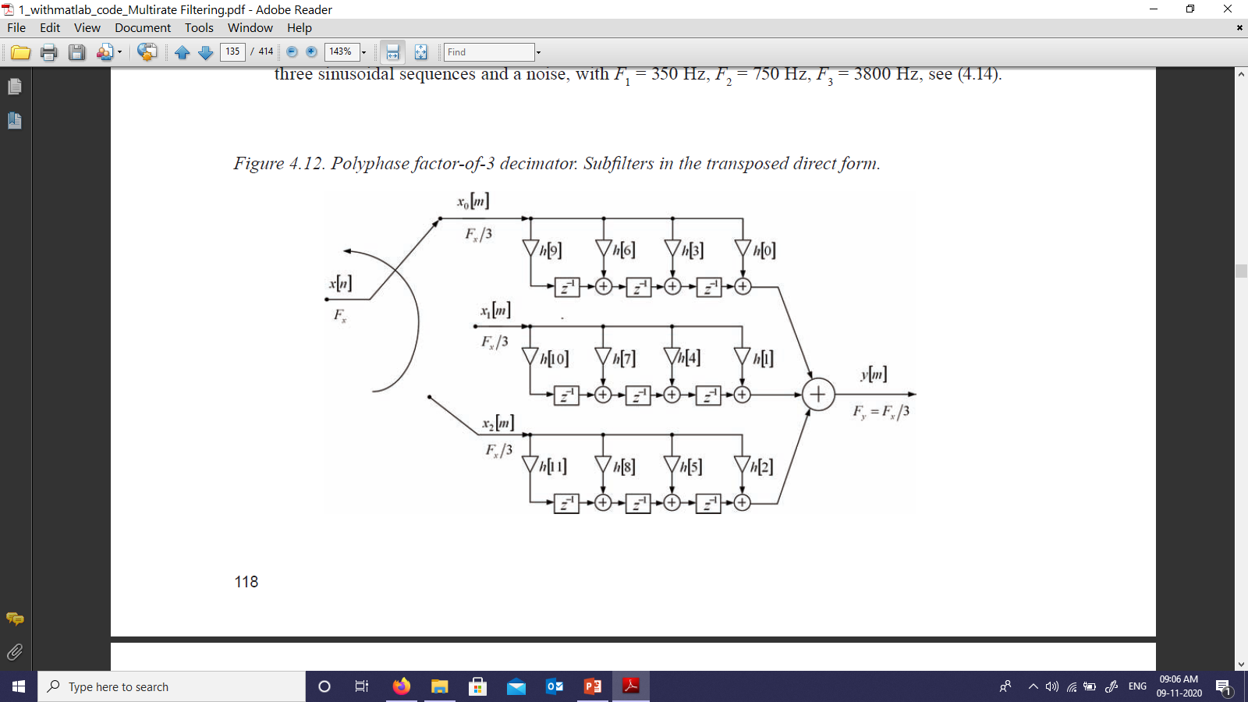

Slide 51
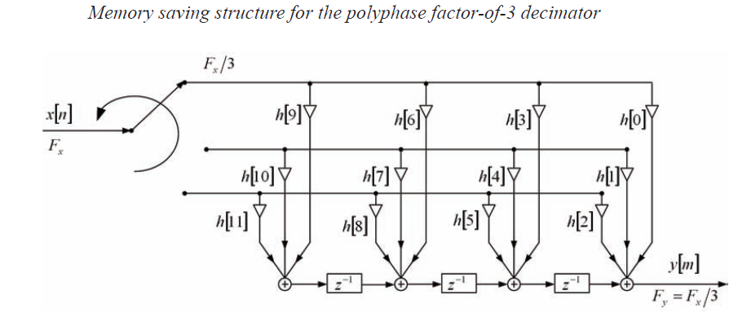

Slide 52
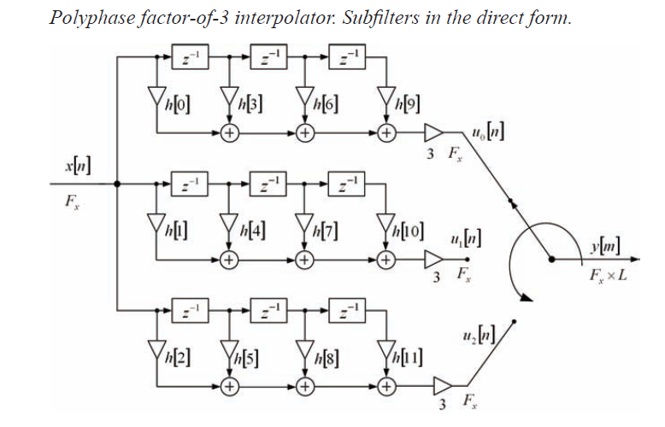

Slide 53
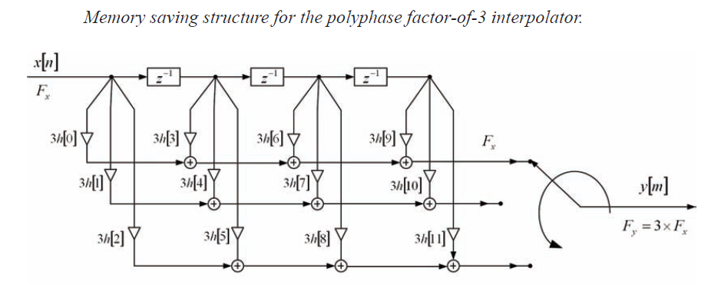

Slide 54
Thank you
Any questions

Slide 55
Content will be discussed as below
Natural flow of code to chip design
Code >> RTL >> schematic and layout
Details of code is not important here ,
Only functionality we will take into account
I will try my best to make you closer to vlsi-dsp concepts and practical approach if you are ready there.

Slide 56




Basic terms that I will use here [expecting all you know these terms]
Critical path [ longest path without ff ]
Or longest path of combinational circuit

Slide 57





Slide 58
From where Signals we will use [matlab]
Expecting some background of matlab
we are taking matlab help for all conversions
Float <> fixed <> hex <> decimal etc
Coefficient conversion etc
and primary design idea like filter design etc.
Filter design for number of taps that we are going to see in rtl design
Signal generations as test signal for circuit

Slide 59
How we will go for vlsi-dsp design here ?
Xilinx
For
Fpga imp
For prototype testing
Will create a
Hdl code
first
Will test the
Code
[simulation]
Cadence
Synopsys
tools
rtl ,
area
power
Chip layout
and other important info.
Signals gen from
matlab

Slide 60

>> codes .v / .vhd
>> 45nm synopsys script file [give RTL]
>> 90nm synopsys script file [give RTL]
>> encounter script file [chip layout]
>> icc script file [chip layout]
>> nclaunch for compile and simulation
>> prime time script file
>> output result goes into this
>> rc compiler script file [give RTL]
>> temp [not in use]
>> work from this we run the tools
Code file and tool setup
Folder with
Code
files
Sys_setup
command
Design vision tool gives >> rtl , area , power and other important info.
Encounter , ICC compiler gives >> chip layout and other information.
Rtl compiler gives >> rtl , area , power and other information.
Nclaunch/vcs >> simulation ,hdl to c model from verification [vcs]
To run the tcl file command is >>> Source filename.tcl <<<

Slide 61
Every script file has these main steps
Read .v / .vhd codes
Analyze the codes
Elaborate the main top module
And rest of the things are
lib path ,
report files generation etc.

Slide 62
direct_form_of_fir_filter1_coeff1_setup1
direct_form_of_fir_filter1_csymt1_setup1
transpose_form_of_fir_filter1_setup1
test_df_filter14
test_tf_filter141
test_tf_filter142 (coeff sys)
AHB_Testsys
AXI
Fix_add_mul_test1
Fp_add_mul_test1 >> for tool flow walkthrough
http://spiral.ece.cmu.edu/mcm/gen.html
https://www.h-schmidt.net/FloatConverter/IEEE754.html
https://www.micro-ip.com/product.php?cid=428
http://ngspice.sourceforge.net/spices.html

Slide 63
Current Trends in VLSI Design
1] Smaller device's, increasing the wafer dimensions
2] High speed
3] Low power
4] bicmos , soi , etc
5] asic, soc,
6] High density FPGA’s
8] Memories
9] High frequency RF communications
10] High speed low power processor, single core, multi-core
11] High speed data convertors
12] Communication protocols [ambha, axi, axi4 etc]
13] Compression
14] Cryptography algorithms
15] Image, video processing
16] Interconnect interface [ noc, switch, hub etc]

Slide 64

Some of the DSP trends and applications

Slide 65

Understanding AMBA Bus Architecture and Protocols
Advanced Micro controller Bus Architecture (AMBA)

Slide 66


AHB-Lite block diagram

Slide 67

Evolution of protocols along with the SOC design trends in industry

Slide 68

Diagram shows how an AXI interconnect can be used to build an SOC with various functional blocks talking through a master-slave protocol

Slide 69
AXI Interconnect Core Use Models
Pass Through
Conversion Only
N-to-1 Interconnect
1-to-N Interconnect
N-to-M Interconnect (Sparse Crossbar)
N-to-M Interconnect (Shared Access Mode)

Slide 70


Slide 71





Slide 72

The interconnect could be a custom crossbar or a switch design or even an off the shelve NOC (Network on Chip) IP that supports multiple AXI masters and slaves

Slide 73

Pin out of AXI unit , looks complex

Slide 74


AXI stream waveform
The AXI4 Stream I/F has a high grade of flexibility, it has some signals that are required and many that are optional. The following signals of the bus will be implemented in code: Clock (the AXI stream bus is synchronous)
Data
Ready and Valid (for data flow control)
Tlast (end of packet)

Slide 75

AXI master stream signalling

Slide 76

AXI master - slave stream signalling

Slide 77
APB : The Advanced Peripheral Bus (APB) is used for connecting low bandwidth. peripherals
AHB: The Advanced High-performance Bus (AHB) is used for connecting components that need higher bandwidth on a shared bus.
AHB-lite protocol is a simplified version of AHB. The simplification comes with support for only a single master design.
AXI: The Advanced Extensible interface (AXI) is useful for high bandwidth and low latency interconnects.[AXI-lite AXI-stream.
ACE — AXI Coherence extension protocol is an extension to AXI 4 protocol and evolved in the era of multiple CPU cores with coherent caches getting integrated on a single chip.
ACE-Lite — The ACE also has a simplified version of protocol ACE.
CHI — Coherent Hub Interface — The ACE protocol was developed as an extension to AXI to support coherent interconnects.

Slide 78

Fixed and floating point
% A matlab [2018b] code for my way of conversion
% construct struc for fixed
struct.mode = 'fixed';
struct.roundmode = 'ceil';
struct.overflowmode = 'saturate';
struct.format = [32 28];
q = quantizer(struct);
%-------------------------------------------------
v1 = 0.25
v2 = -0.35
d1 = dec2hex(bin2dec(num2bin(q,v1)),8)
d2 = dec2hex(bin2dec(num2bin(q,v2)),8)
d11 = bin2num(q,dec2bin(hex2dec(d1)))
d22 = bin2num(q,dec2bin(hex2dec(d2)))
[num2str(v1) num2str(v2) ,' ' ,d1 ,' ' ,d2, ' ', num2str(d11) ,' ' num2str(d22)]
ans = '0.25 -0.35 04000000 FA666667 0.25 -0.35'
Variable size
32/64 bit size

Slide 79

Schematic of float add mul and LUT no 1602 on kintex7

Slide 80

Floating point add mul Simulation result

Slide 81

Schematic Fixed point[32,28] and LUT No 75 on kintex-7

Slide 82

Fixed point add mul Simulation result

Slide 83


Slide 84


Slide 85


Slide 86

Synopsys Design Compiler basic tool flow

Slide 87

RTL level (Register Transfer Level) into a netlist simple flow diagram.

Slide 88

From RTL To GDSⅡ design process

Slide 89

Flowchart front end

Slide 90

From netlist To GDSⅡ in the design process

Slide 91

From Schematic To GDSⅡ design process

Slide 92


Tcl Script{for design vision tool} look like as below
2
1

Slide 93

3

Slide 94


Tcl Script{for RTL compiler tool} look like as below
1
2
Encounter Tcl Script we will see at the time of use

Slide 95
Direct form of FIR filter

Slide 96



Slide 97


Slide 98



Slide 99


Slide 100

Transpose form of FIR filter

Slide 101


Slide 102


Slide 103


Slide 104



Bit serial and digit serial design

Slide 105


Bit serial adder

Slide 106
Digit serial ( size is 2 ) digit_SA2

Slide 107


Slide 108


Slide 110
Thank You
Questions
?

